Slide 1



LOB CUSKIT LAUNCH DASHBOARD
IMPACTED BY COVID-19
CHIN WOOI LING

Slide 2
AGENDA
Project Background
Data Exploration
Prediction Model
Data Visualization
Conclusion

Slide 3
Data Visualization
Predictive Modelling
Generating forecast by analyzing current & historical data
Project Roadmap
Featured Engineering
Select, manipulate and transform raw data into features
Data Exploration
Explore & visualize data
Identify data & patterns to dig more
Data Cleaning
Drop rows with “NA”
Remove low variance columns
Define categorical & numerical columns
Data Mining
Covid-19 Data Analysis
LOB Cuskit Launch
LOB Cuskit Revenue
Business Problem Understanding

Slide 4


Slide 5


Slide 6
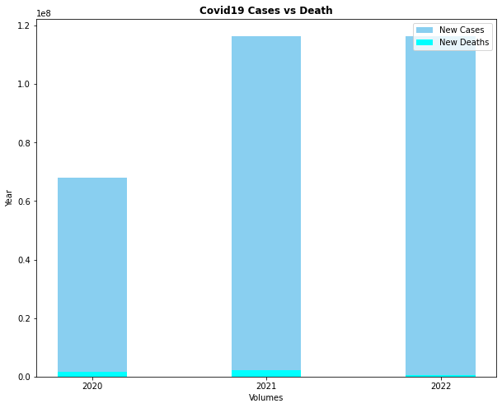
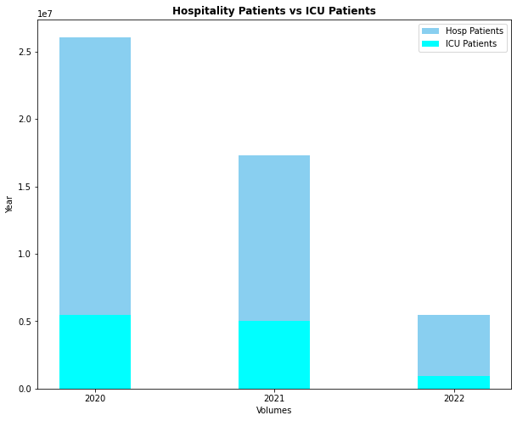
Covid-19 Analysis

Slide 7


Slide 8


Slide 9
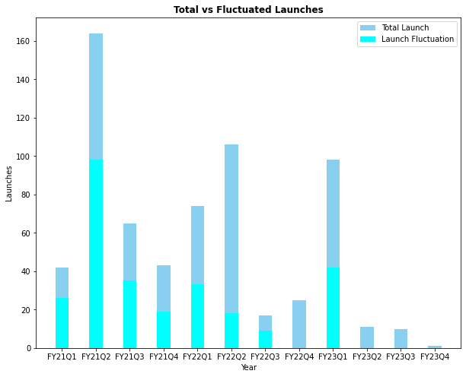
TOTAL
VS FLUCTUATED LAUNCHES

Slide 10
Data Cleaning
Covid-19 Dataset
LOB Cuskit Revenue
Global data
Drop rows with “NA”
Remove low variance columns
Daily refresh
Columns: 67 → 9
Rows: 171k → 640
Weekly refresh
Drop rows with “NA”
Remove low variance columns
Columns – 9 → 6
Rows – 104k → 15k

Slide 11
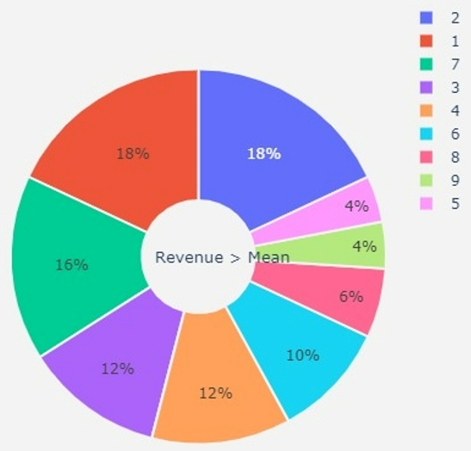
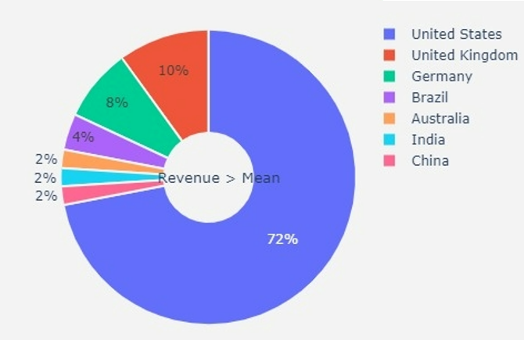
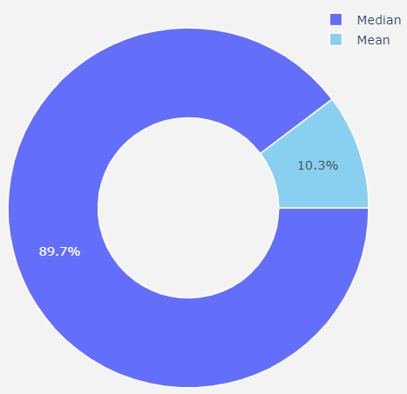
18% Revenue generated from newly created SKU
Data exploration
72% Revenue generated from US
89.7% Median Revenue

Slide 12
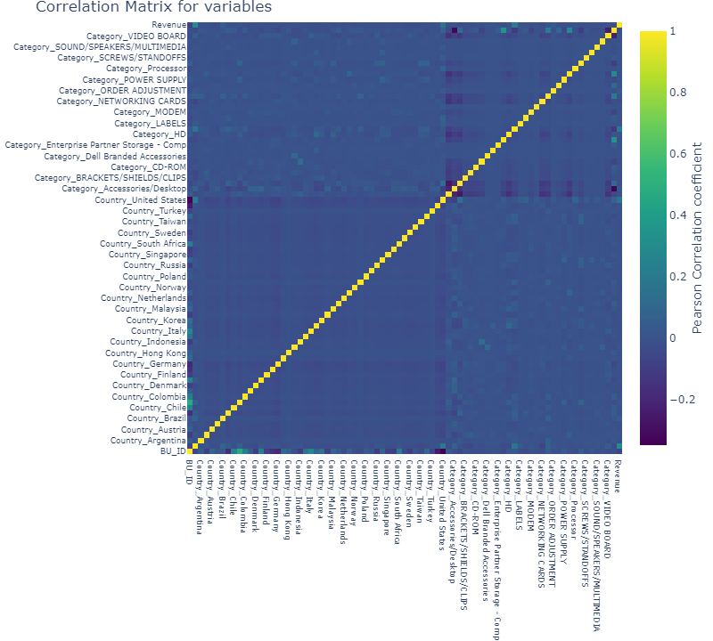
Feature Selection
Heatmap of correlated variables

Slide 13
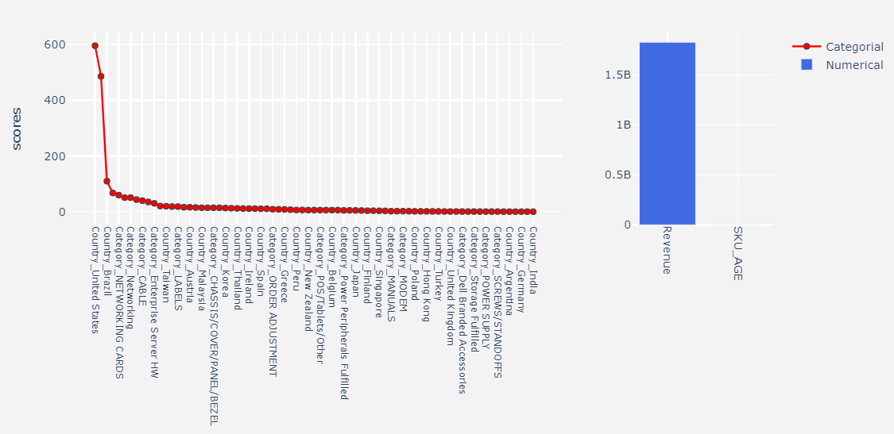
Scores for Categorical & Numerical Features

Slide 14
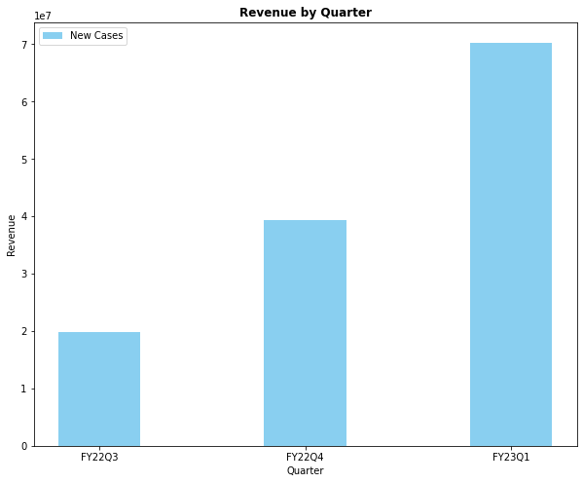
Revenue by Quarter

Slide 15
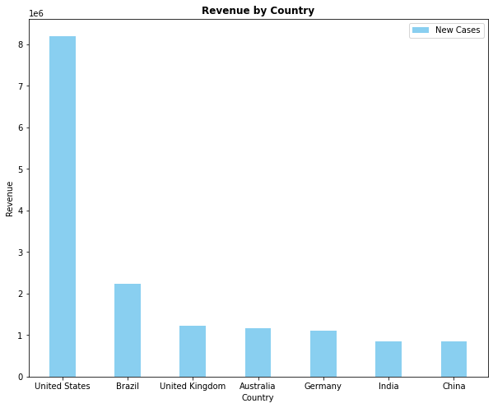
Revenue by Country

Slide 16
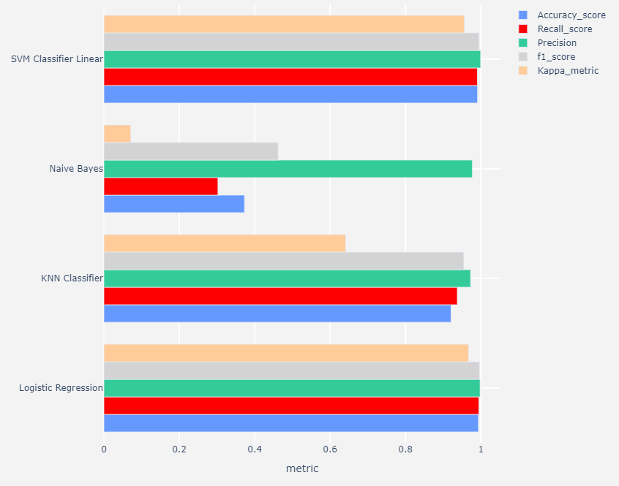
Model’s Performance

Slide 17
Limitation
Limited data source due to LOB Cuskit Transition from FY22Q2 onwards
Limited knowledge on the data science to analyze the outcome
Limited time frame to complete this project

Slide 18

Future work
Forecast revenue by analyzing Covid-19 data
How does it impact to the revenue?
Will it generate more revenue?

